Slide 1
ELECTVIZ
ELECTION DATA VISUALIZATION FOR MEDIA
Mentor : Mrs. Nityashree S J
Presentation by : BHAVISHYA PRIYADARSHINI V

Slide 2
Introduction
Elections generate massive amounts of data across states, parties, candidates, and years.
Analyzing such data manually is time-consuming and error-prone.
This project uses Power BI to analyze and visualize Indian General Election data.
The goal is to convert raw election data into clear, interactive, and meaningful insights.

Slide 3
System Design and Workflow
Raw Data
Data Cleaning
Data Modeling
System Design
Workflow
Data collection from Indian General Election datasets.
Data cleaning and preprocessing
Data modeling and relationship creation
Dashboard design and visualization
sight extraction and analysis
Visualization
Insights

Slide 4
Features Enhancement
Interactive slicers for year, state, region, and party
Dynamic dashboards with real-time filtering
Multiple analysis pages (Overview, Turnout, Gender, Party, Region)
Use of maps, KPIs, charts, and tables for better understanding
User-friendly layout for easy navigation

Slide 5
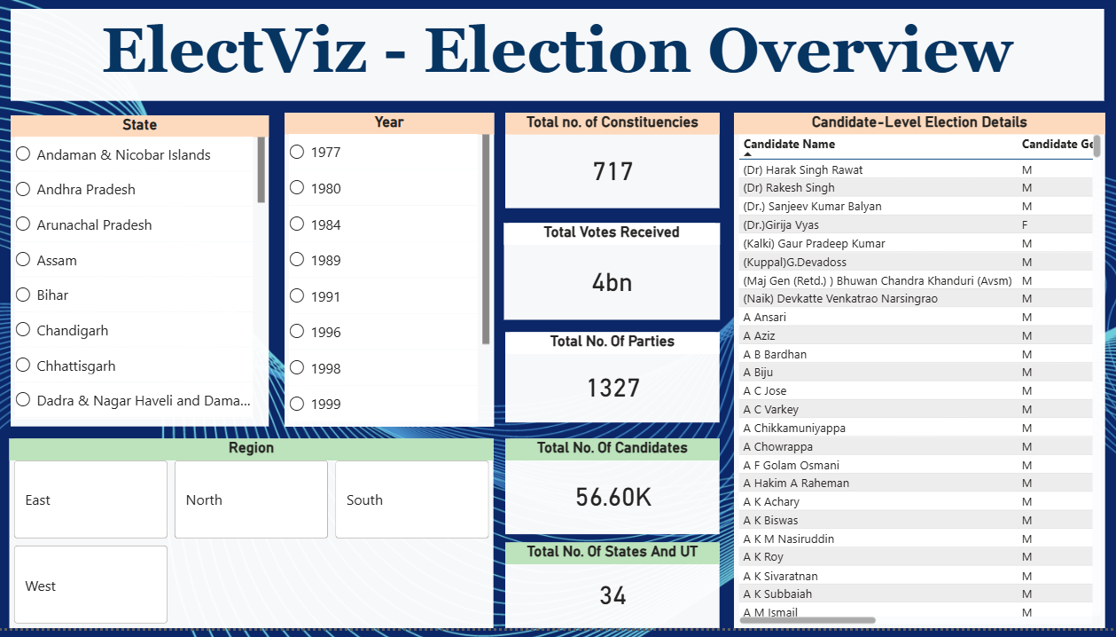
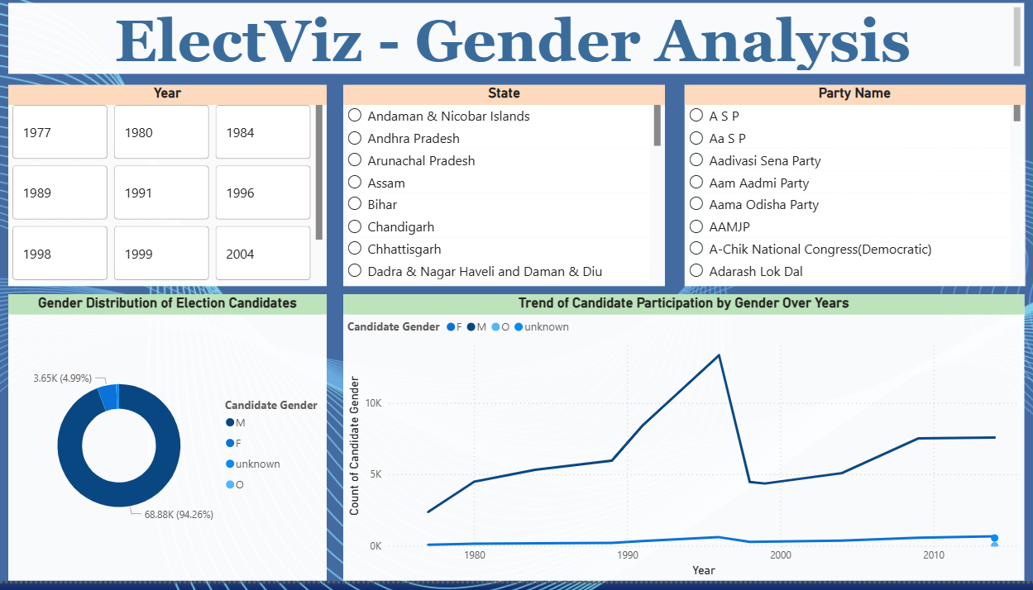
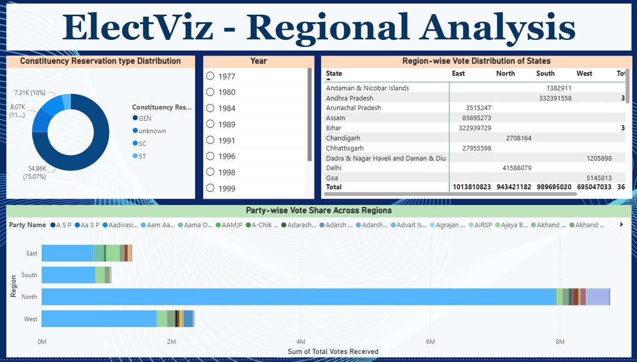
Dashboard

Slide 6
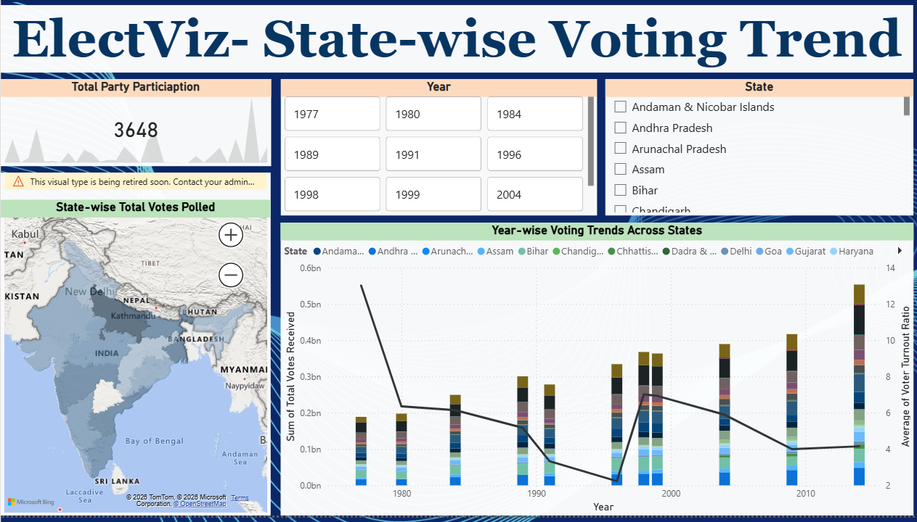
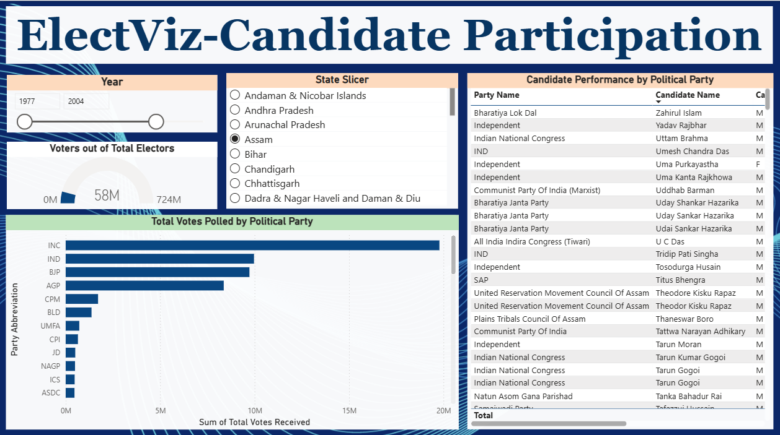
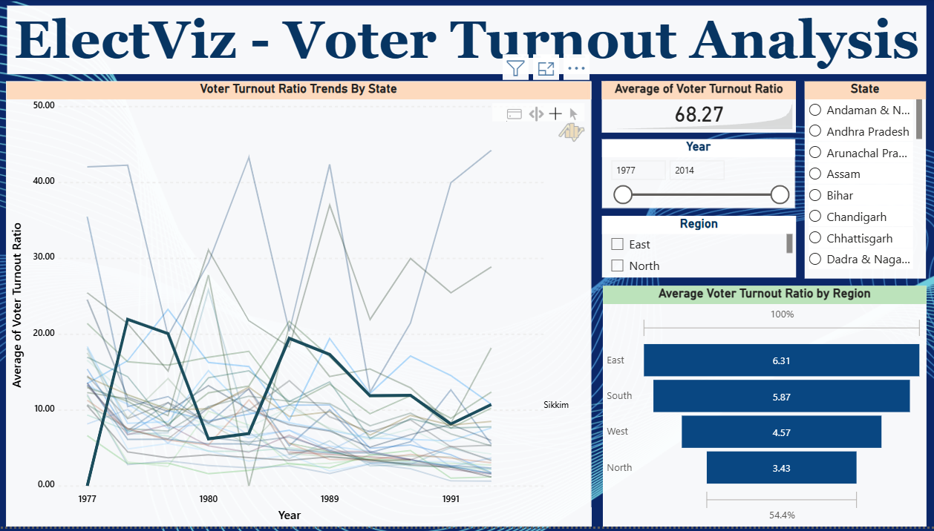
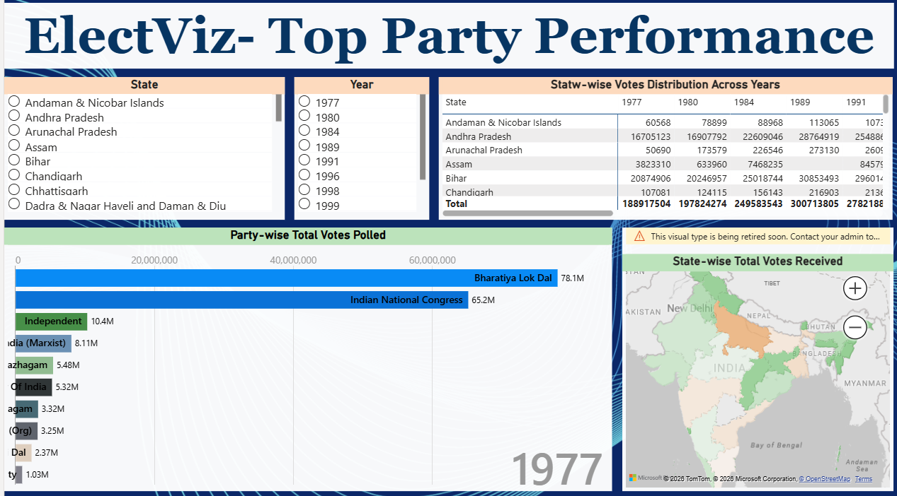

Slide 7
Conclusion
The project successfully visualizes complex election data using Power BI.
It reveals trends in voter turnout, party performance, gender imbalance, and regional dominance.
Interactive dashboards support data-driven decision making.
This project demonstrates the power of data visualization in understanding democratic processes.

Slide 8
Thank You

